Slide 1
Middle School YARP
2015-2016

Slide 3
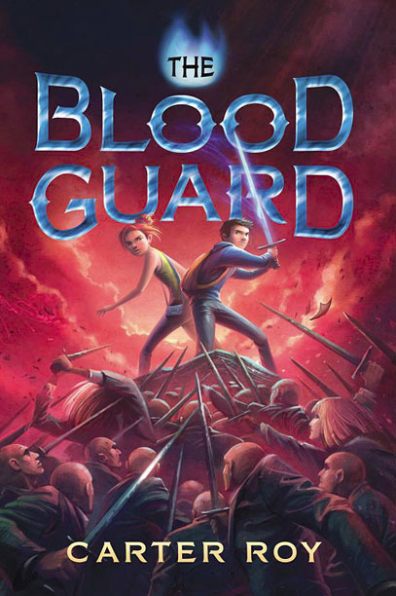

Slide 5
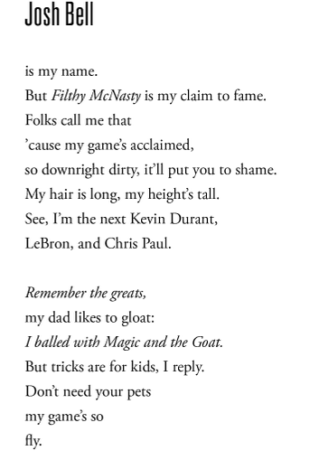
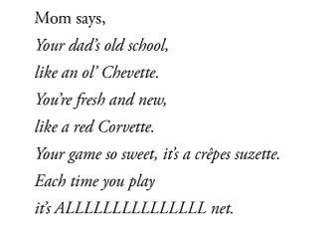
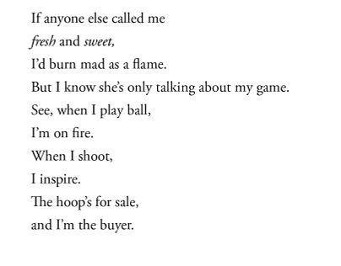

Slide 9
Notes:
YouTube Disney Video showing the Seven Summits he climbed. Both links work. https://youtu.be/_dcL-PJUFRI https://www.youtube.com/watch?v=_dcL-PJUFRI&feature=youtu.be

Slide 11
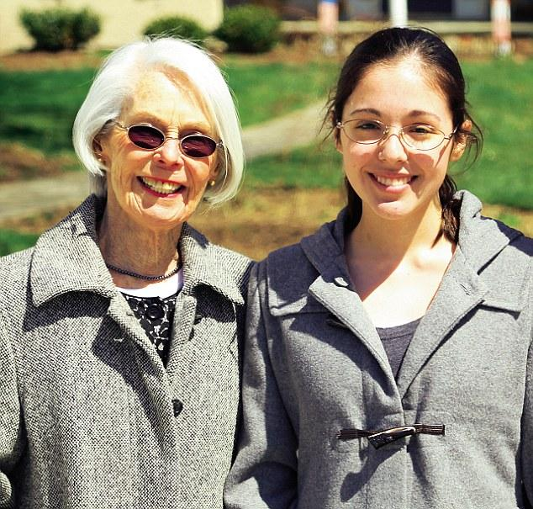

Slide 17
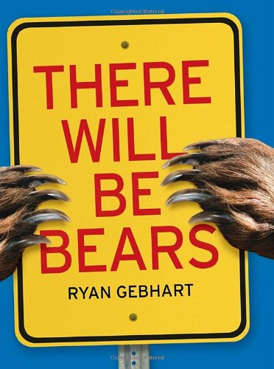

Slide 18
"The Ability (The Ability, #1)." Goodreads. N.p., n.d. Web. 22 Sept. 2015.
"Carter Roy Talks New Middle Grade Novel, 'The Blood Guard'" Carter Roy Talks New Middle Grade Novel, 'The Blood Guard' N.p., n.d. Web. 22 Sept. 2015.
"El Deafo." Goodreads. N.p., n.d. Web. 22 Sept. 2015.
"A Matter of Days." Goodreads. N.p., n.d. Web. 22 Sept. 2015.
"No Summit out of Sight." No Summit out of Sight. N.p., n.d. Web. 22 Sept. 2015.
"Popular." Goodreads. N.p., n.d. Web. 22 Sept. 2015.
"The Rule of Three (The Rule of Three, #1)." Goodreads. N.p., n.d. Web. 22 Sept. 2015.
"The School for Good and Evil (The School for Good and Evil, #1)." Goodreads. N.p., n.d. Web. 22 Sept. 2015.
"Soldier Dog." Goodreads. N.p., n.d. Web. 22 Sept. 2015.
"Tandem (Many-Worlds, #1)." Goodreads. N.p., n.d. Web. 22 Sept. 2015.
"There Will Be Bears Hardcover – April 22, 2014." There Will Be Bears: Ryan Gebhart: 9780763665210: Amazon.com: Books. N.p., n.d. Web. 22 Sept. 2015.

